Slide 1
LPS (Logic-based Production System)
Robert Kowalski and Fariba Sadri
Imperial College London

Slide 2
LPS (Logic-based Production System)
Robert Kowalski and Fariba Sadri
Imperial College London
Incomplete, but usable implementation under development at:
https://bitbucket.org/lpsmasters/lps_corner
with acknowledgements to Miguel Calejo

Slide 3
LPS (Logic-based Production System)
A logic and computer language for practical
programming
databases
AI knowledge representation and problem solving

Slide 4
Outline:
LPS gives a logical semantics to production systems
LPS combines reactive rules with logic programs
The Turing test in LPS
Bank account transfer in LPS
Dining philosophers in XSB/Studio implementation of LPS
CLOUT (Computational Logic for Use in Teaching in Schools)

Slide 5
Production Systems
Combine states described by a working memory of facts.
state transitions represented by condition-action rules.
Popular for implementing expert systems.
as a computational model of human thinking
(e.g. SOAR, ACT, Steven Pinker’s How the Mind Works)

Slide 6
Production systems do not have a logical semantics.
threat ⇒ deal-with-threat
fire ⇒ threat
flood ⇒ threat
deal-with-threat ⇒ eliminate
deal-with-threat⇒ escape

Slide 7
Production systems do not have a logical semantics.
threat ⇒ deal-with-threat
fire ⇒ threat
flood ⇒ threat
deal-with-threat ⇒ eliminate
deal-with-threat⇒ escape
Adding fire to working memory
triggers two candidate actions eliminate and escape.
Conflict resolution decides between them.

Slide 8
LPS combines logic programs and FOL reactive rules
Reactive rule: threat → deal-with-threat
Logic program: threat ← fire
threat ← flood
deal-with-threat ← eliminate
deal-with-threat ← escape

Slide 9
LPS combines logic programs and FOL reactive rules
Reactive rule: threat → deal-with-threat
Logic program: threat ← fire
threat ← flood
deal-with-threat ← eliminate
deal-with-threat ← escape
Adding fire to the current state
generates two alternative actions eliminate or escape.
LPS generates one model to make the reactive rule true.
M1 = {fire, threat, deal-with-threat, eliminate} or
M2 = {fire, threat, deal-with-threat, escape}

Slide 10
LPS combines logic programs and FOL reactive rules
Reactive rule: threat → deal-with-threat
Logic program: threat ← fire
threat ← flood
deal-with-threat ← eliminate
deal-with-threat ← escape
Adding fire to the current state
generates two alternative actions eliminate or escape.
LPS generates one model to make the reactive rule true.
M1 = {fire, threat, deal-with-threat, eliminate} or
M2 = {fire, threat, deal-with-threat, escape}
The current implementation in Prolog generates M1.

Slide 11
LPS combines logic programs with reactive rules in FOL.
e.g. logic programs
e.g. reactive rules

Slide 12
reactive rule

Slide 13
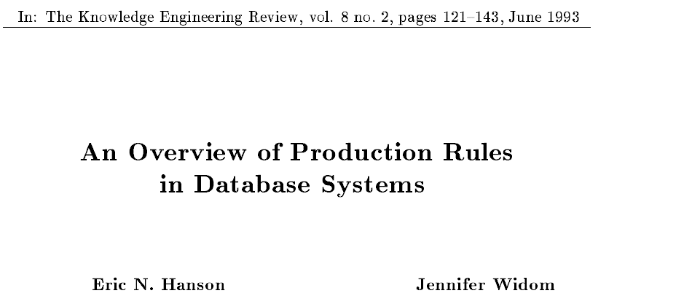
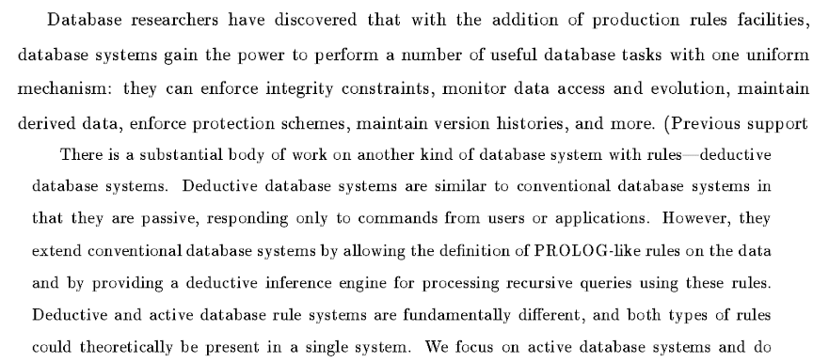

Slide 14
LPS combines logic programs and FOL reactive rules

Slide 15
LPS combines logic programs and FOL reactive rules
Reactive rules in FOL:
∀X [antecedent → ∃ Y [consequent]
or antecedent → consequent
or if antecedent then consequent

Slide 16
LPS combines logic programs and FOL reactive rules
Reactive rules in FOL:
∀X [antecedent → ∃ Y [consequent]
or antecedent → consequent
or if antecedent then consequent
Clauses in logic programming form:
∀X [conditions→ conclusion]
or conclusion← conditions
or conclusion if conditions

Slide 17
LPS combines logic programs and FOL reactive rules
Reactive rules in FOL:
∀X [antecedent → ∃ Y [consequent]
or antecedent → consequent
or if antecedent then consequent
Clauses in logic programming form:
∀X [conditions→ conclusion]
or conclusion← conditions
or conclusion if conditions
Atomic sentences are a special case of clauses.

Slide 18
LPS combines logic programs and FOL reactive rules
Reactive rules in FOL:
∀X [antecedent → ∃ Y [consequent]
or antecedent → consequent
or if antecedent then consequent
Clauses in logic programming form:
∀X [conditions→ conclusion]
or conclusion← conditions
or conclusion if conditions
Atomic sentences are a special case of clauses.
The syntax of LPS is fluid.

Slide 19
The Turing Test (not completely catered for in the current implementation)
sentence(Agent, T1, T3) ←
noun-phrase(Agent, T1, T2) ∧
verb-phrase(Agent, T2, T3)
noun-phrase(Agent, T1, T3) ←
adjective(Agent, T1, T2) ∧
noun(Agent, T2, T3)
adjective(Agent, T1, T2) ←
say(Agent, your, T1, T2)
noun(Agent, T1, T2) ←
say(Agent, name, T1, T2)
etc.

Slide 20
The Turing Test (not completely catered for in the current implementation)
sentence(turing, T1, T2) → sentence(robot, T3, T4) ∧ T2 < T3 < T2 + 3 sec
sentence(Agent, T1, T3) ←
noun-phrase(Agent, T1, T2) ∧
verb-phrase(Agent, T2, T3)
noun-phrase(Agent, T1, T3) ←
adjective(Agent, T1, T2) ∧
noun(Agent, T2, T3)
adjective(Agent, T1, T2) ←
say(Agent, your, T1, T2)
noun(Agent, T1, T2) ←
say(Agent, name, T1, T2)
etc.

Slide 21
The same clauses can be used to recognise complex events and to generate complex plans
Observed events: say(turing, what, 1, 2)
say(turing, is, 2, 3)
say(turing, your, 3, 4)
say(turing, name, 4, 5)
Action events: say(robot, my, 7, 8)
say(robot, name, 8, 9)
say(robot, is, 9, 10)
say(robot, bob, 10, 11)
The actions make the reactive rule true.

Slide 22
States and events can be described by atomic sentences
without time stamps
for efficient updates
with time stamps
for logical semantics

Slide 23
States and events can be described by atomic sentences
without time stamps
for efficient updates
States (sets of facts, also called fluents}:
balance(bob, 0)
with time stamps
for logical semantics
balance(bob, 0, 31/08/2016)

Slide 24
States and events can be described by atomic sentences
without time stamps
for efficient updates
States (sets of facts, also called fluents):
balance(bob, 0)
Events (including actions):
transfer(fariba, bob, 10)
with time stamps
for logical semantics
balance(bob, 0, 31/08/2016)
transfer(fariba, bob, 10,
31/08/2016, 1/9/2016)

Slide 25
State transitions are performed by destructive updates
without explicit timestamps.
state at time 0: balance(bob, 0) balance(fariba, 100)

Slide 26
State transitions are performed by destructive updates
without explicit timestamps.
state at time 0: balance(bob, 0) balance(fariba, 100)
events from time 0 to time 1: transfer(fariba, bob, 10)
state at time 1: balance(bob, 10) balance(fariba, 90)

Slide 27
State transitions are performed by destructive updates
without explicit timestamps.
state at time 0: balance(bob, 0) balance(fariba, 100)
events from time 0 to time 1: transfer(fariba, bob, 10)
state at time 1: balance(bob, 10) balance(fariba, 90)
events from time 1 to time 2: transfer(fariba, bob, 20)
state at time 2: balance(bob, 30) balance(fariba, 70)

Slide 28
State transitions are performed by destructive updates
without explicit timestamps.
state at time 0: balance(bob, 0) balance(fariba, 100)
events from time 0 to time 1: transfer(fariba, bob, 10)
state at time 1: balance(bob, 10) balance(fariba, 90)
events from time 1 to time 2: transfer(fariba, bob, 20)
state at time 2: balance(bob, 30) balance(fariba, 70)
events from time 2 to time 3:
state at time 3: balance(bob, 30) balance(fariba, 70)
etc.

Slide 29
State transitions are performed by destructive updates
without explicit timestamps.
state at time 0: balance(bob, 0) balance(fariba, 100)
events from time 0 to time 1: transfer(fariba, bob, 10)
state at time 1: balance(bob, 10) balance(fariba, 90)
events from time 1 to time 2: transfer(fariba, bob, 20)
state at time 2: balance(bob, 30) balance(fariba, 70)
events from time 2 to time 3:
state at time 3: balance(bob, 30) balance(fariba, 70)
etc.
Frame axioms are emergent properties, not used for computation:
balance(X, N, T2) ← balance(X, N, T1) ∧
¬ transfer(X, Y, V, T1, T2) ∧ ¬ transfer(Y, X, W, T1, T2)

Slide 30
State transitions are described by a causal theory with or without timestamps
Postconditions:
balance(X, N-V, T2) ← transfer(X, Y, V, T1, T2) ∧ balance(X, N, T1)
balance(Y, M+V, T2) ← transfer(X, Y, V, T1, T2) ∧ balance(Y, M, T1)

Slide 31
State transitions are described by a causal theory with or without timestamps
Postconditions:
balance(X, N-V, T2) ← transfer(X, Y, V, T1, T2) ∧ balance(X, N, T1)
balance(Y, M+V, T2) ← transfer(X, Y, V, T1, T2) ∧ balance(Y, M, T1)
Preconditions:
not [transfer(X, Y, V, T1, T2) ∧ balance(X, N, T1) ∧ V > N]
not [transfer(X, Y1, V1, T1, T2) ∧ transfer(X, Y2, V2, T1, T2) ∧ Y1 ≠ Y2]
etc.

Slide 32
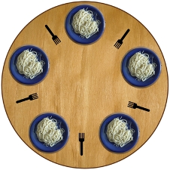
The Dining Philosophers

Slide 33
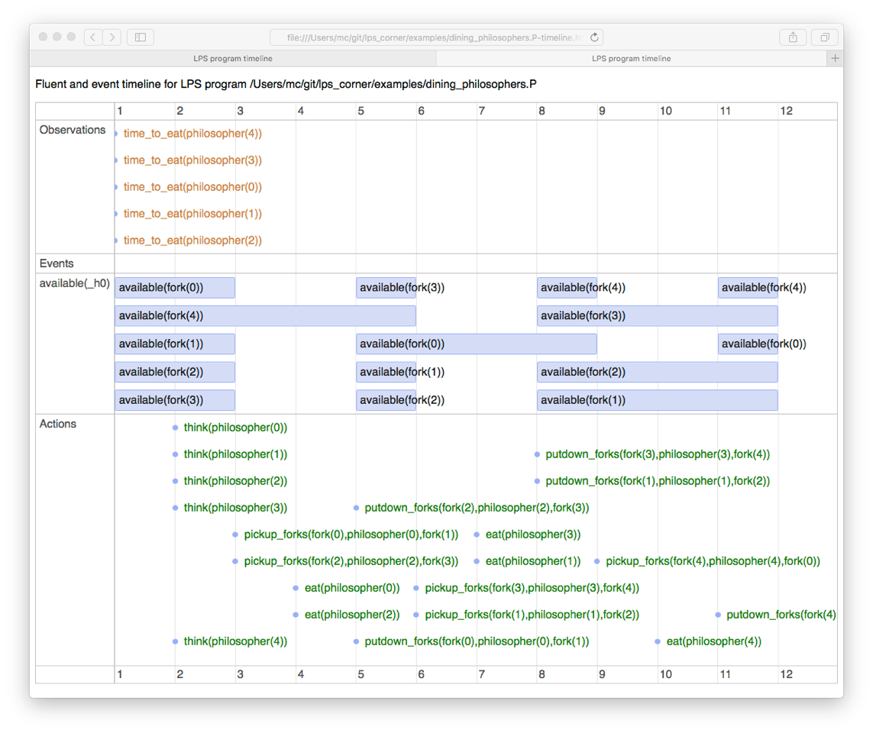

Slide 34
Dining philosophers (in the XSB/Studio implementation)
fluent(available(Fork)).
event(time_to_eat(Philosopher)).
action(think(Philosopher)).
action(pickup_forks(Fork1, Philosopher, Fork2)).
action(eat(Philosopher)).
action(putdown_forks(Fork1, Philosopher, Fork2)).

Slide 35
Dining philosophers (in the XSB/Studio implementation)
fluent(available(Fork)).
event(time_to_eat(Philosopher)).
action(think(Philosopher)).
action(pickup_forks(Fork1, Philosopher, Fork2)).
action(eat(Philosopher)).
action(putdown_forks(Fork1, Philosopher, Fork2)).
initial_state( [ available(fork(0)),
available(fork(1)),
available(fork(2)),
available(fork(3)),
available(fork(4)) ] ).

Slide 36
Dining philosophers (in the XSB/Studio implementation)
fluent(available(Fork)).
event(time_to_eat(Philosopher)).
action(think(Philosopher)).
action(pickup_forks(Fork1, Philosopher, Fork2)).
action(eat(Philosopher)).
action(putdown_forks(Fork1, Philosopher, Fork2)).
initial_state( [ available(fork(0)),
available(fork(1)),
available(fork(2)),
available(fork(3)),
available(fork(4)) ] ).
l_timeless(adjacent(fork(1),philosopher(1),fork(2)), []).
l_timeless(adjacent(fork(3),philosopher(3),fork(4)), []).
l_timeless(adjacent(fork(0),philosopher(0),fork(1)), []).
l_timeless(adjacent(fork(2),philosopher(2),fork(3)), []).
l_timeless(adjacent(fork(4),philosopher(4),fork(0)), []).

Slide 37
Dining philosophers (in the XSB/Studio implementation)
time_to_eat(philosopher(N),T1,T2) --->
dine(philosopher(N),T3,T4), tc(T2 =< T3).

Slide 38
Dining philosophers (in the XSB/Studio implementation)
time_to_eat(philosopher(N),T1,T2) --->
dine(philosopher(N),T3,T4), tc(T2 =< T3).
observe([time_to_eat(philosopher(0)),
time_to_eat(philosopher(1)),
time_to_eat(philosopher(2)),
time_to_eat(philosopher(3)),
time_to_eat(philosopher(4))], 1).
% currently LPS stops when no further observations exist
observe([],T) :- T > 1, T < 12.

Slide 39
Dining philosophers (in the XSB/Studio implementation)
time_to_eat(philosopher(N),T1,T2) --->
dine(philosopher(N),T3,T4), tc(T2 =< T3).
observe([time_to_eat(philosopher(0)),
time_to_eat(philosopher(1)),
time_to_eat(philosopher(2)),
time_to_eat(philosopher(3)),
time_to_eat(philosopher(4))], 1).
% currently LPS stops when no further observations exist
observe([],T) :- T > 1, T < 12.
dine(philosopher(N),T1,T6) :-
think(philosopher(N),T1,T2),
adjacent(F1,philosopher(N),F2),
pickup_forks(F1,philosopher(N),F2,T3,T4), tc(T2 =< T3),
eat(philosopher(N),T4,T5),
putdown_forks(F1,philosopher(N),F2,T5,T6).

Slide 40
Dining philosophers (causal theory)
false :- pickup_forks(F1,philosopher(N),F2,T1,T2),
not available(F1,T1).
false :- pickup_forks(F1,philosopher(N),F2,T1,T2),
not available(F2,T1).
false :- pickup_forks(F1,philosopher(N),F,T1,T2),
pickup_forks(F,philosopher(K),F2,T1,T2).

Slide 41
Dining philosophers (causal theory)
false :- pickup_forks(F1,philosopher(N),F2,T1,T2),
not available(F1,T1).
false :- pickup_forks(F1,philosopher(N),F2,T1,T2),
not available(F2,T1).
false :- pickup_forks(F1,philosopher(N),F,T1,T2),
pickup_forks(F,philosopher(K),F2,T1,T2).
initiated available(F1) :-
putdown_forks(F1,philosopher(N),F2,T1,T2).
initiated available(F2) :-
putdown_forks(F1,philosopher(N),F2,T1,T2).
terminated available(F1) :-
pickup_forks(F1,philosopher(N),F2,T1,T2).
terminated available(F2) :-
pickup_forks(F1,philosopher(N),F2,T1,T2).

Slide 43
CLOUT (Computational Logic for Use in Teaching)
A six month project (October 2016 – March 2017)
to develop an open-source, web-based prototype of LPS together with motivating, modifiable examples,
to support computing in schools.

Slide 44
CLOUT (Computational Logic for Use in Teaching)
A six month project (October 2016 – March 2017)
to develop an open-source, web-based prototype of LPS together with motivating, modifiable examples,
to support computing in schools.
Collaborators are very welcome.

Slide 45
Conclusions
LPS gives a logical, model-theoretic semantics for practical
programming and
databases.
LPS is not a full-scale AI framework,
but it can be extended.

